Slide 1
Incident Prediction – Initial analysis
By –
Vaishnavi EM, Rashmi Kulkarni, Shraddha Mankar, Sucharita Mukherjee

Slide 2
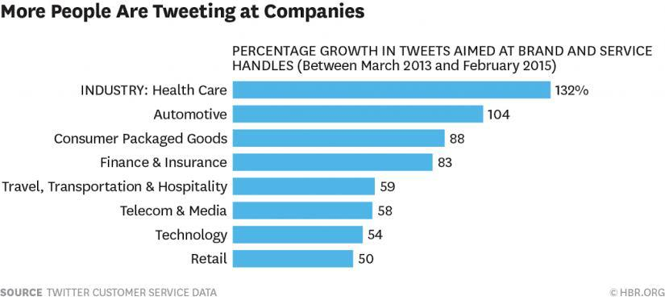
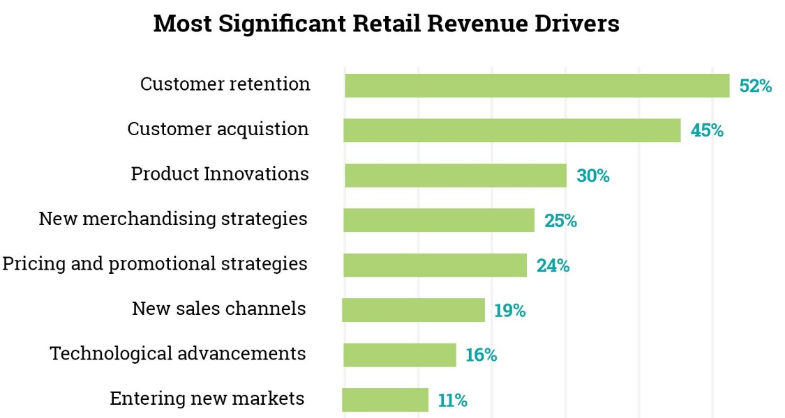
Background Study
Increasing digital footprint of almost every product and service industry is leading to a huge digital data load. The same data can be used for a better CRM(Customer relationship management)
With advent and easy access of multiple social media and other platforms its imperative that people are sharing feedbacks-grievances and more at a much higher pace.
Along with genuine concerns industries today also face a lot of scam-fake-negative-repetitive feedbacks-grievances, so it is importance to device a solution that can prioritise important concerns and can facilitate a better customer satisfaction leading to better customer acquisition.

Slide 3
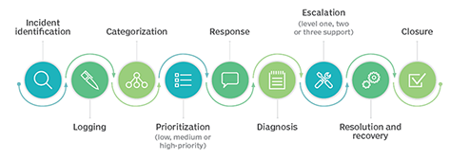
Business Objective
To predict the impact of the incident raised by the customer by prioritising the incident as high-medium-low priority.
The dataset is having incidents raised by customers. Which contains an event log of an incident management process extracted from a service desk platform of an IT company.
Incident management workflow
(reference: https://searchitoperations.techtarget.com/definition/IT-incident-management)

Slide 4
Data Acquisition
The event log is enriched with data loaded from a relational database underlying a corresponding process-aware information system.
Dimension of the data is 1,41,712 incidents(rows) and 25 attributes(columns).
The attribute details are as follows:
ID : Incident identifier (24,918 different values)
ID_status : Eight levels controlling the incident management process transitions from opening until closing the case
Active : Boolean attribute that shows whether the record is active or closed/canceled
count_reassign : Number of times the incident has the group or the support analysts changed
count_opening : number of times the incident resolution was rejected by the caller
count_updated : number of incident updates until that moment
ID_caller : identifier of the user affected

Slide 5
Data Acquisition contd.. (getting hold of useful information)
opened_by : identifier of the user who reported the incident
opened_time : Incident user opening date and time
Created_by : identifier of the user who registered the incident
created_at : incident system creation date and time
updated_by : identifier of the user who updated the incident and generated the current log record
updated_at : incident system update date and time
type_contact : categorical attribute that shows by what means the incident was reported
location : identifier of the location of the place affected
Category Id : first-level description of the affected service
user_symptom : description of the user perception about service availability

Slide 6
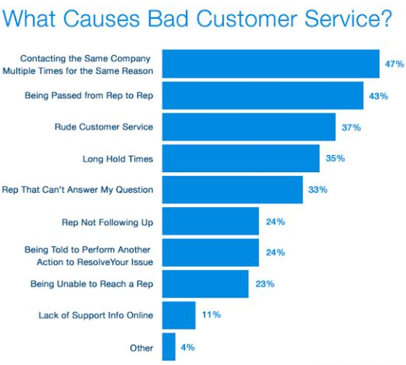
Data Acquisition contd.. (getting hold of useful information)
Impact - description of the impact caused by the incident (values: “1:High” ; “2:Medium” ; “3:Low”)
Support_group - identifier of the support group in charge of the incident
support_incharge - identifier of the user in charge of the incident
Doc_knowledge - boolean attribute that shows whether a knowledge base document was used to resolve the incident
confirmation_check - boolean attribute that shows whether the priority field has been double-checked
Notify - Categorical attribute that shows whether notifications were generated for the incident
Problem_id - identifier of the problem associated with the incident
change_request - identifier of the change request associated with the incident;

Slide 7
Understanding the collected information Data types – Object (16), Integer(3), Date & Time (3), Bool (3),
Object | Object | Integer | Date & Time | Boolean
ID | user_symptom | count_reassign | opened_time | Active
ID_Status | IMPACT (target) | count_opening | created_at | Doc_knowledge
ID_caller | Support_group | count_updated | updated_at | confirmation_check
opened_by | support_incharge
Created_by | notify
updated_by | problem_id
type_contact | Change request
location
category_ID

Slide 8
Understanding the distribution of the data Study of skewness and kurtosis of the numerical and Boolean data values
Attribute | Skewness | Kurtosis | Interpretation
Active | -1.7 | 0.9 | Negatively skewed data, there is long tail in the beginning, which comprise majority of the data
Count_reassign | 3.1 | 16.5 | Positively skewed data, there is long tail at the end, which comprise majority of the data
Count_opening | 15.6 | 344.3 | Positively skewed data, there is long tail at the end, which comprise majority of the data
Count_updated | 4.7 | 35.4 | Positively skewed data, there is long tail at the end, which comprise majority of the data
Doc_knowledge | 1.7 | 0.8 | Positively skewed data, there is long tail at the end, which comprise majority of the data
Confirmation_check | 0.9 | -1.1 | Positively skewed data, there is long tail at the end, which comprise majority of the data
The data distribution is not symmetrical and does not follow the normal distribution patter. There are certain high and multiple low frequency points in the dataset

Slide 9
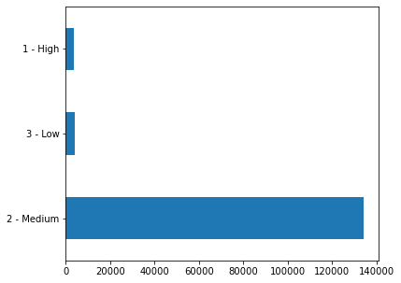
Visualizing the target distribution
The data set is highly imbalanced with: 3491 High priority incidents, 134335 Medium priority incidents and 3886 Low priority incidents. Indicating a highly imbalanced dataset.

Slide 10
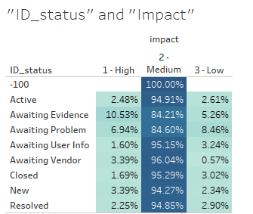
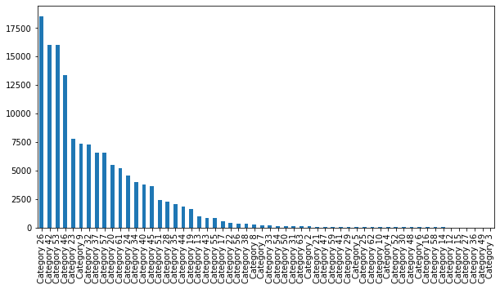
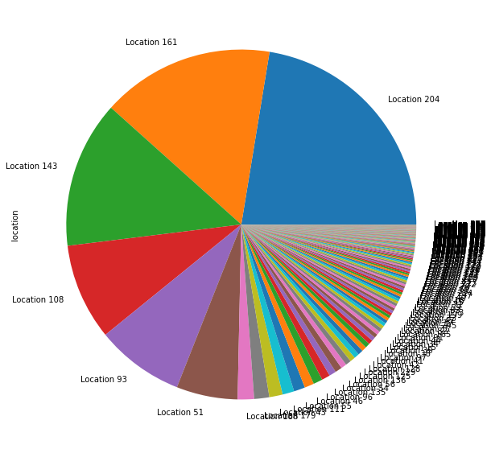
Visualizing few of the predictors
Certain particular “labels” from different attributes have a much higher effect in prediction for eg: category 26,42,53,46, location 204, 141, 108, 93, 51, active, new and resolved labels. All 3 attributes have a say in prediction

Slide 11
Impact of different labels of the predictors
Going through other attributes leads us to the following observations:
Group 70 in "support_grp" account for 40.7%
Sym 491 in "user_symptom" account for 59.9%
Category 26,42,53,46,23 and 9 in "category_id" accounts for almost 50%
Location 204,161,143 in "location" account for almost 57%
Phone under "type_contact" account for 99%
“Updated_by”908, 44, 60 account for 40%
“Created by” 10 account for 55%
True in "confirmation check" account for 71 %
False in "doc_knowledge" account for 82%
4/7/16 and 17/3/16 have almost 37% values under "created_at"
0,1,2,3,4 in “count_updated” account for 64%
0 in “count_opening” account for 98%
0,1,2 in “count_reassign” account for almost 85%
True in "active" account for 82%
“Change request” and “problem_id” have almost 98% values missing

Slide 12
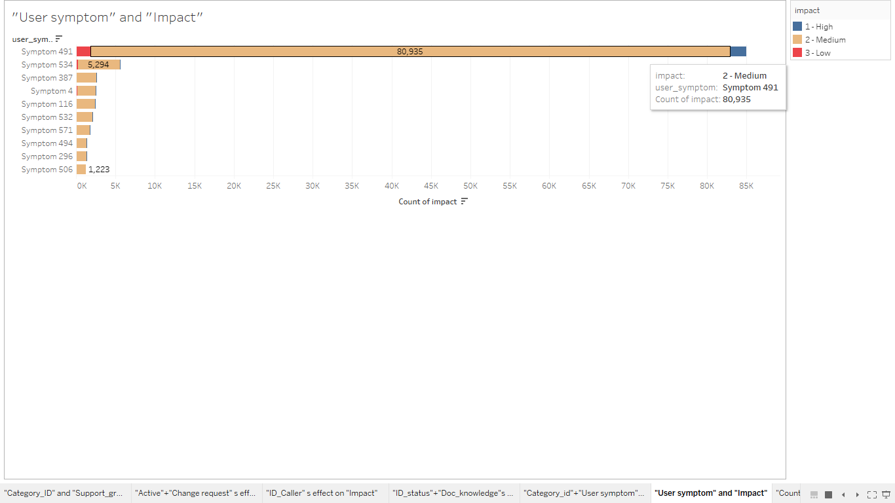
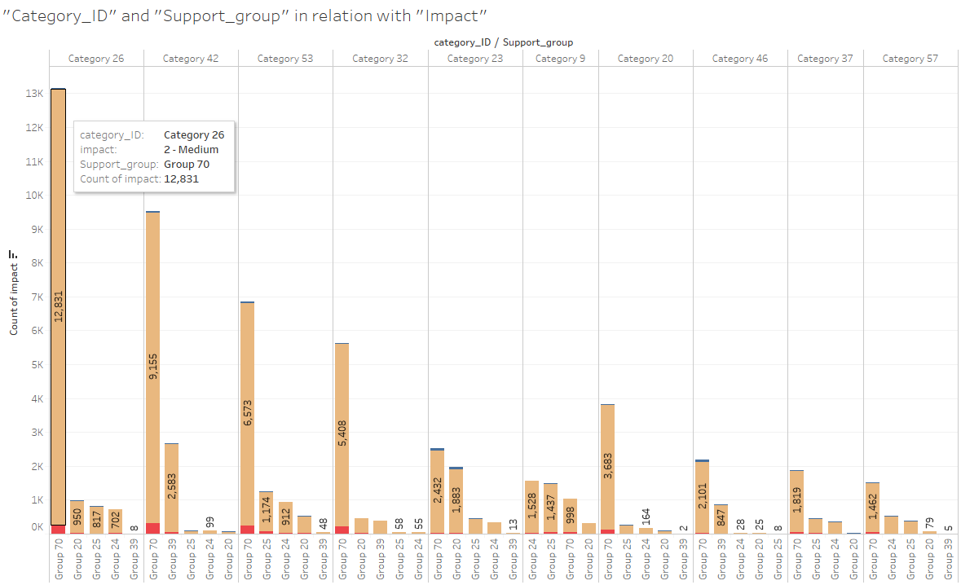
Certain Categories and Support groups have majority of the incidents
For eg: “Category_id” 26, and “Support_group” 70, 20, 25, 24, 39 have maximum incidents
“Category” and “Sub-category” have an effect on “Impact”

Slide 13
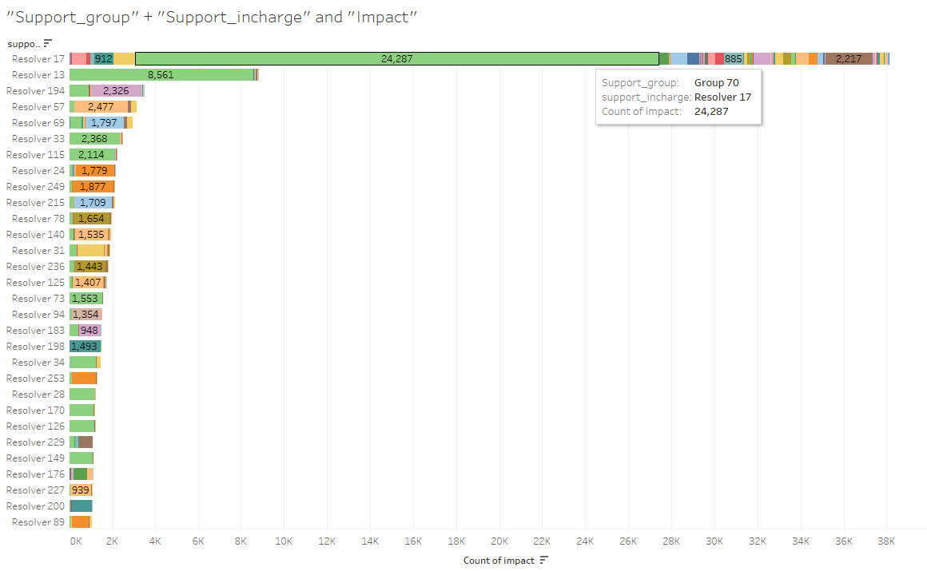
“Support_Incharge” (17) have dealt with majority of the incidents
Majority of the “Support_Incharge” who dealt with issues belong with similar “Support_group” (eg:70) irrespective of “Impact” classes
“Support_incharge” and “Support_group” doesnot have much prediction power

Slide 14
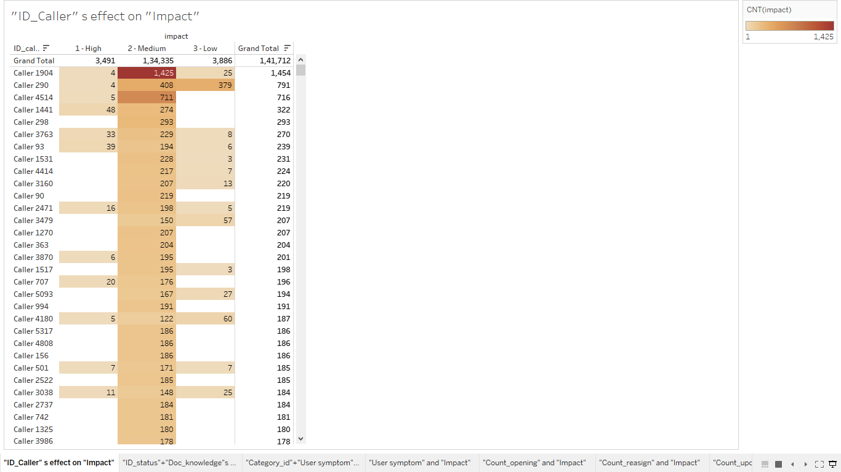
Certain “ID_Caller” have a high count of incidents, while the rest have much lower counts. There are majorly 4 cluster (>=700), (<700 and >=150), (<150 and >=50) and (<50)
“User symptoms” 491, and 534 seems to have majority of the incidents, irrespective of the incident type, rendering other values much powerless, with very minor incidents getting registered to others
“ID_caller” seem to have an effect on “Impact” while “User symptoms” doesn't seem to have an effect on the “Impact”

Slide 15
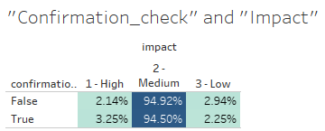
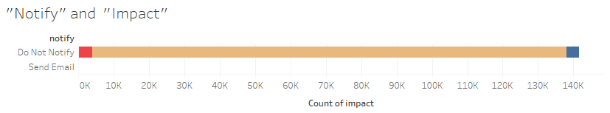
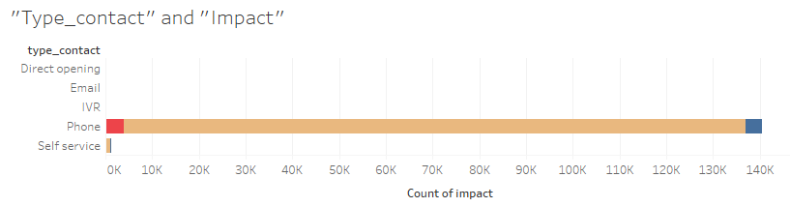
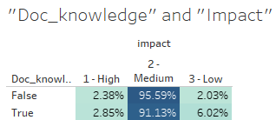

1.“Notify”, “Type_contact”, “Active” have same distribution irrespective of “Impact” class
2.“Confirmation_Check” and “Doc_knowledge” have almost equal proportion of “Impact” classes for both true and false criteria
None of the attributes have major role in prediction and can be discarded

Slide 16
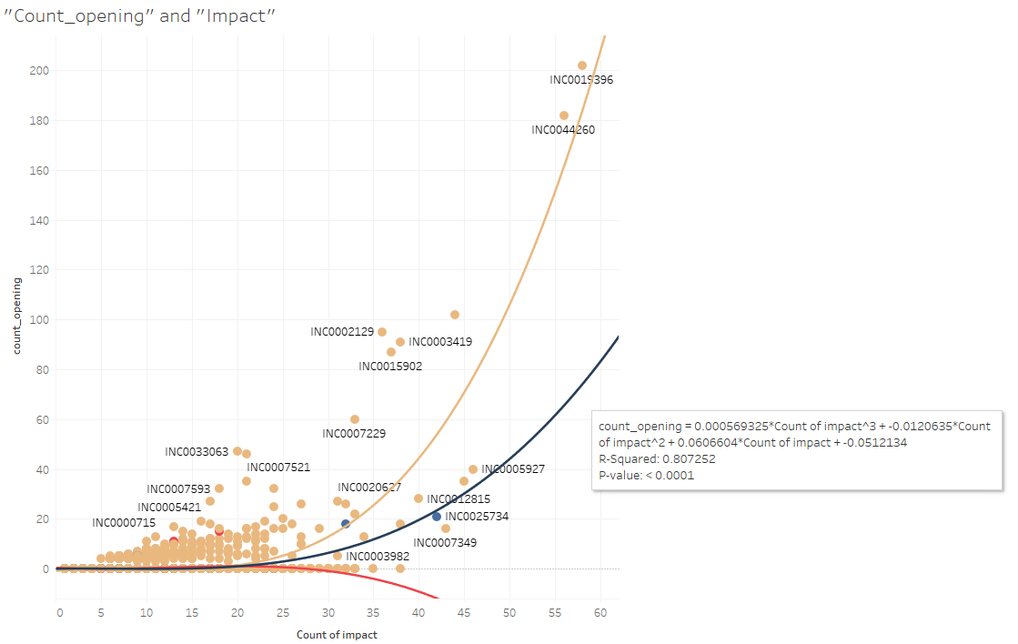
“Count_opening” and “High Impact” doesn’t have a direct linear correlation but have a correlation value of 0.80, depicting positive correlation, using a 3rd degree polynomial model, majority of its value are “zero” irrespective of the impact class, so it can be discarded from prediction (rarely users have rejected the solution)

Slide 17
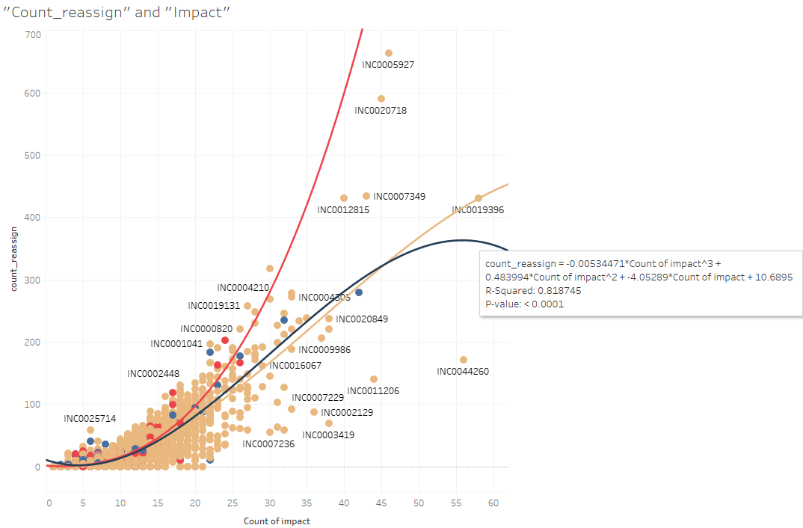
“Count_reassign” and “High Impact” have a correlation value of 0.818, depicting positive correlation, using a 3rd degree polynomial model(multiple number of times support group have been changed), majority datapoint from all classes fall in similar range

Slide 18
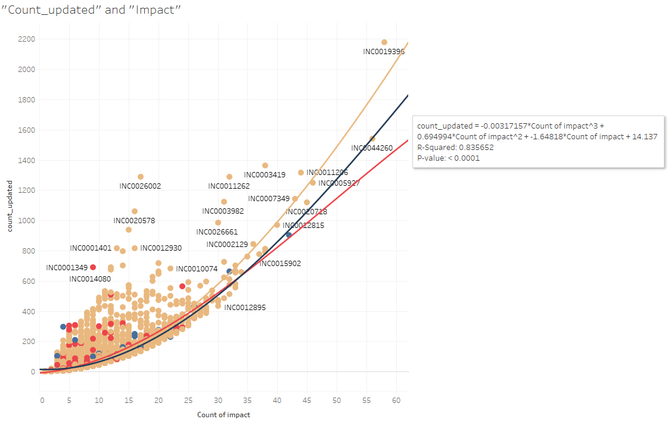
“Count_updated” and “High Impact” have a correlation value of 0.835, depicting positive correlation, using a 3rd degree polynomial model

Slide 19
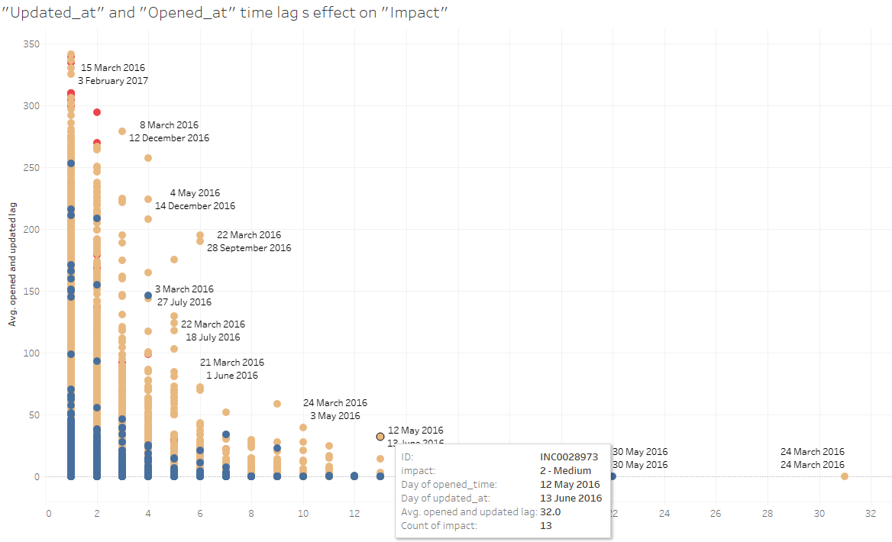
We measured the “Opened_at” and “Updated_at” time lag in days
The “High Impact” incidents have a lower “opened and updated time lag”, with majority in the range of 0-250 days, with average 0-30 days
While “Medium and Low Impact” have a varied range

Slide 20
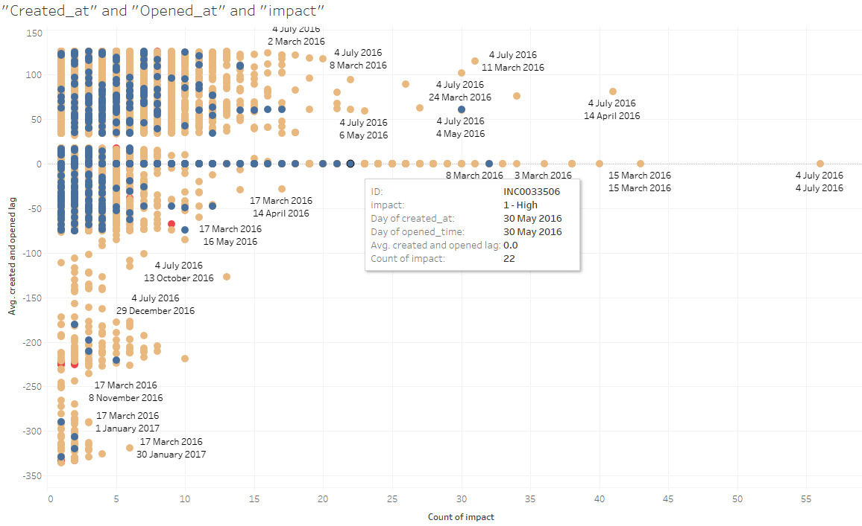
We measured the “Created_at” and “Opened_at” time lag in days
Its visible that “High Impact” incidents are in the average range of (-75 to 125)
The spread is vast and is not conclusive for “Medium and Low Impact” incidents
Negative values depict some data entry anomaly

Slide 21
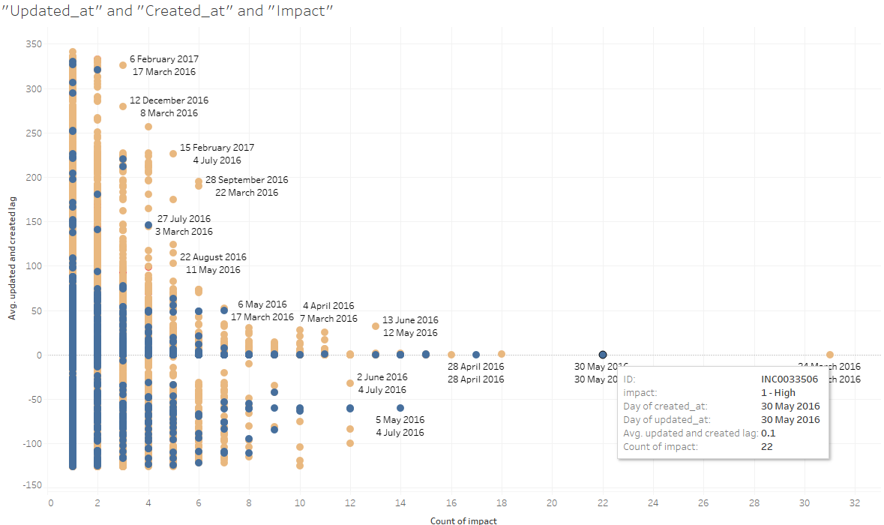
We measured the “Updated_at” and “Created_at” time lag in days
The spread is vast and is not conclusive
Negative values depict some data entry anomaly

Slide 22
Important predictors
Attributes that might have a say in prediction as per visual understanding:
“Category”, “ID_status”, “Location”
“Category”, “Sub_category”
“ID_caller”
“Count_updated”
“Opened_at”, “Updated_at”
While “ count_opening”, “Change request” and “problem_id” have almost 98% values missing and thus can be discarded, while rest attributes wont seem to have major prediction power.

Slide 23
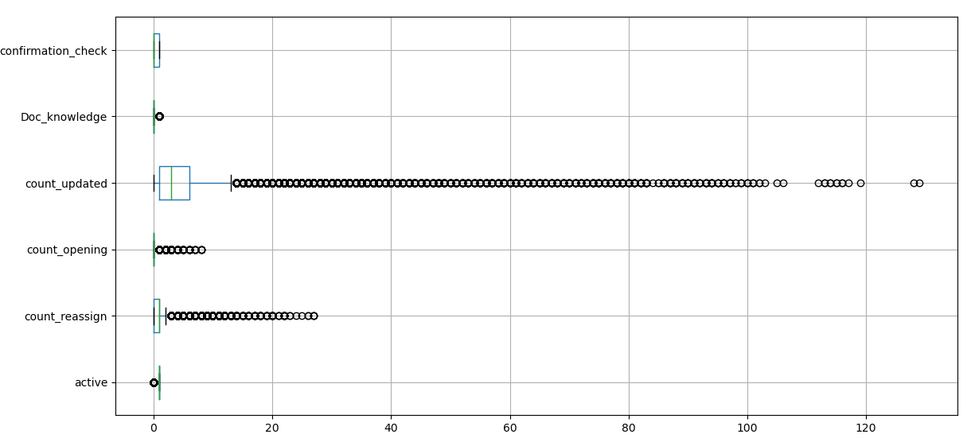
Outliers and Categorical variables
The int(), bool() have certain abnormal data points that might disturb the entire data distribution.
Particularly “count_updated” and “count_reassign” have major outliers
We also label encode categorical variables to prepare them for further usage

Slide 24
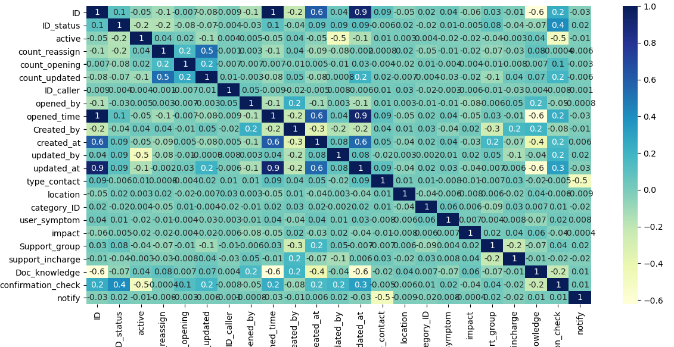
Establishing correlation between different attributes
“opened_at” and “updated_at” have a correlation with “ID” and “opend_at” and “updated_at” are also related. Other attributes are not correlated to each other

Slide 25
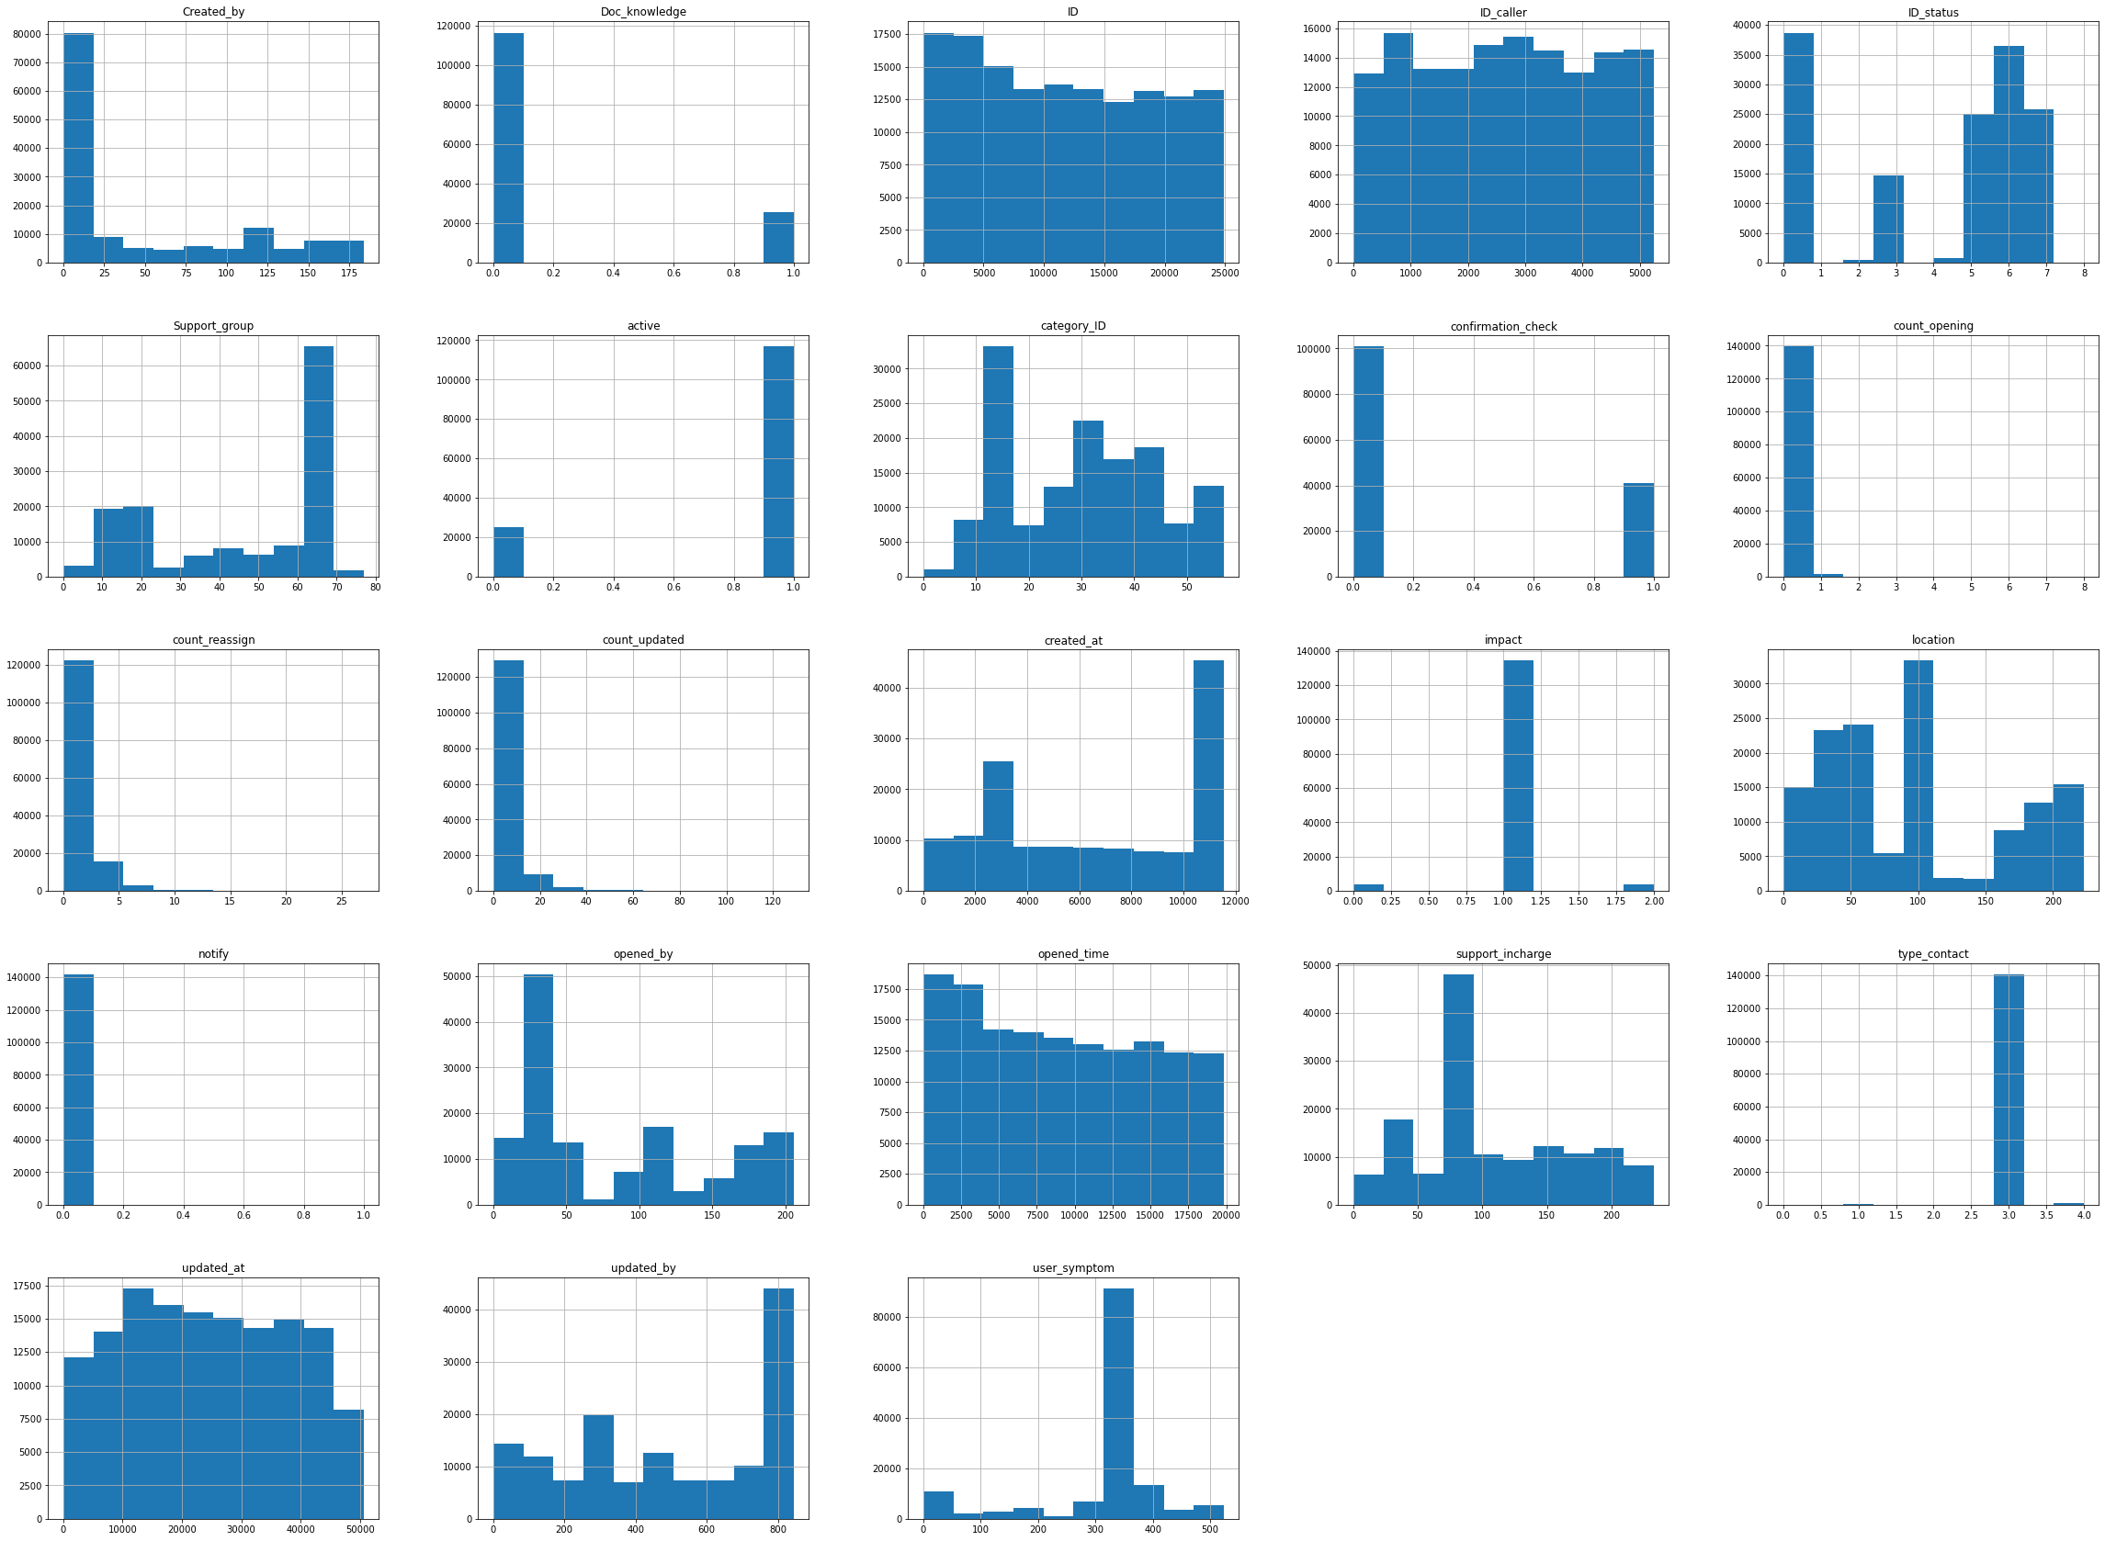
Normality test for each attribute
1.We did a qqplot() and a historgram plot to visualize the data symmetry.
2.Data distribution is not normal post label encoding. But still yielded better skewness and kurtosis values
3.We need to scale and standardize the data

Slide 26
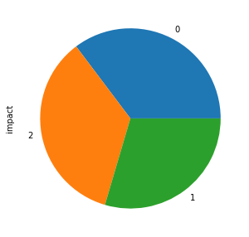
Handle Imbalance
We tried to combine both SMOTE and undersampling as SMOTEENN, to generate a balanced dataset, where labels 0,1,2 denote “high”, “medium” and “low” incidents

Slide 27
Thank You

